Slide 1
Site Storyboard
Maverick Owens

Slide 2
Buyers Experience

Slide 3
The Process
Users will start at homepage
Users will either buy the featured art, or go browse the shop
If they buy the featured art, they will be immediately sent to the checkout page
Otherwise, they will proceed to the shop
They will be able to search and add art
Then proceed to Checkout/Cart to confirm and proceed to payment, a third party service

Slide 4
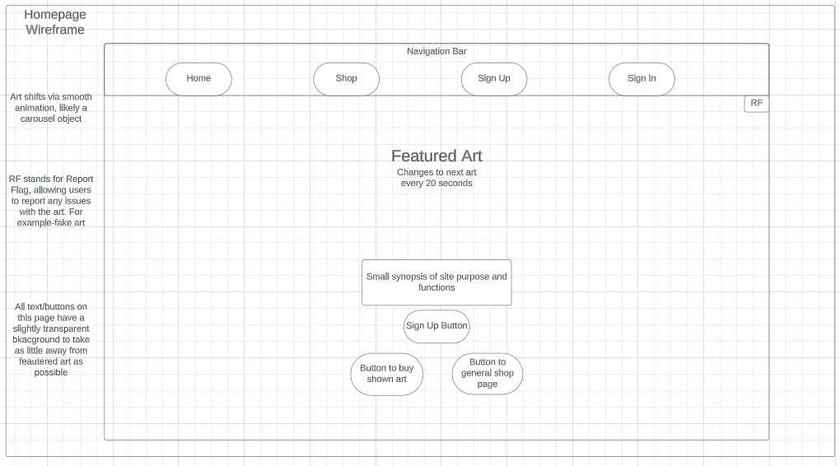

Slide 5
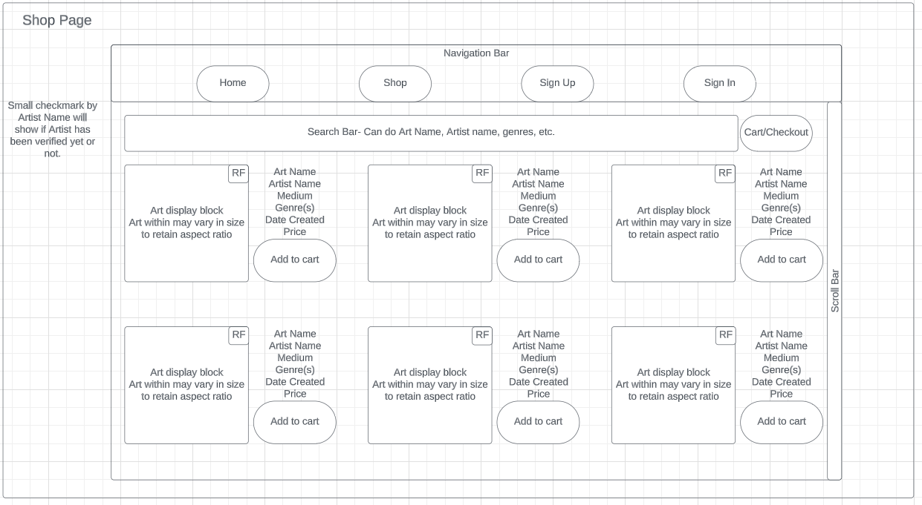

Slide 6
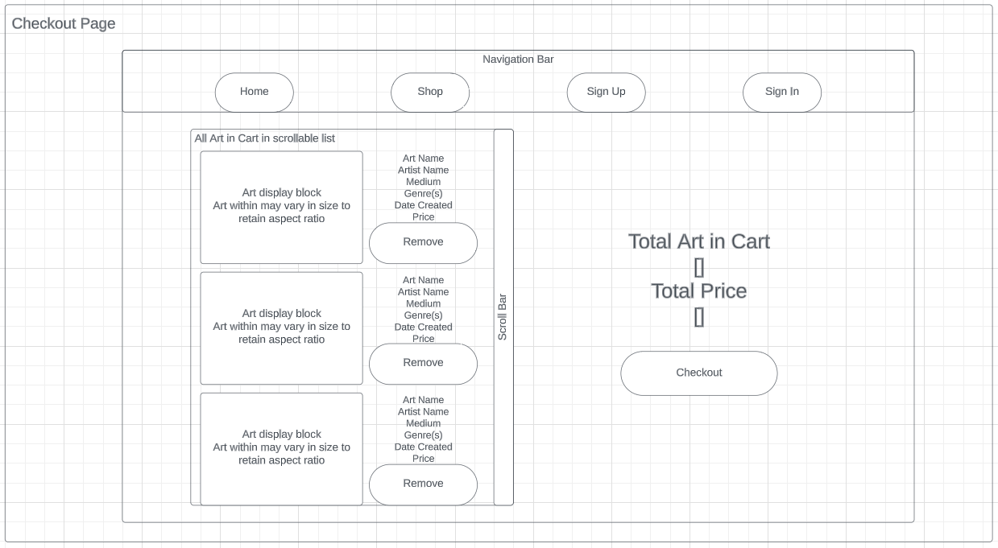

Slide 7
Artist Sign Up

Slide 8
The Process
User goes to sign up page
After sign up, is sent to gallery management page
User will add art
User can verify-sends to third party site. In this scenario, user does verify.
User can Manage Subscription—Sends straight to third party payment page
User can Buy art
After finishing, user hits sign out button-returns to home

Slide 10
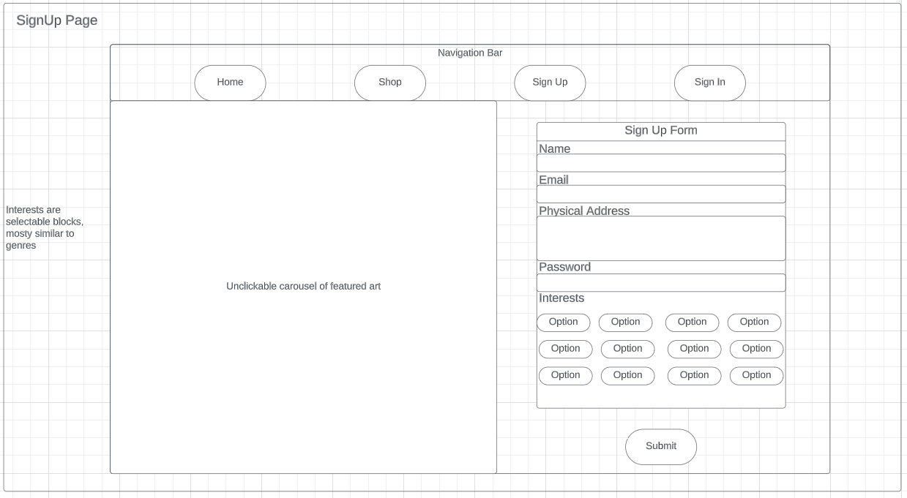

Slide 11
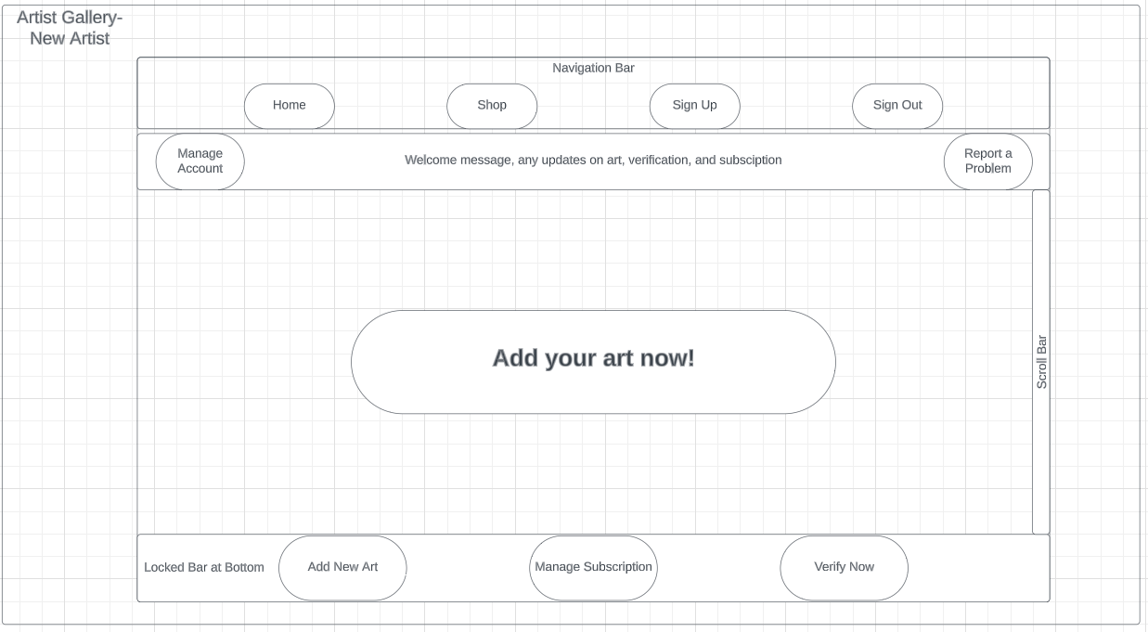

Slide 12
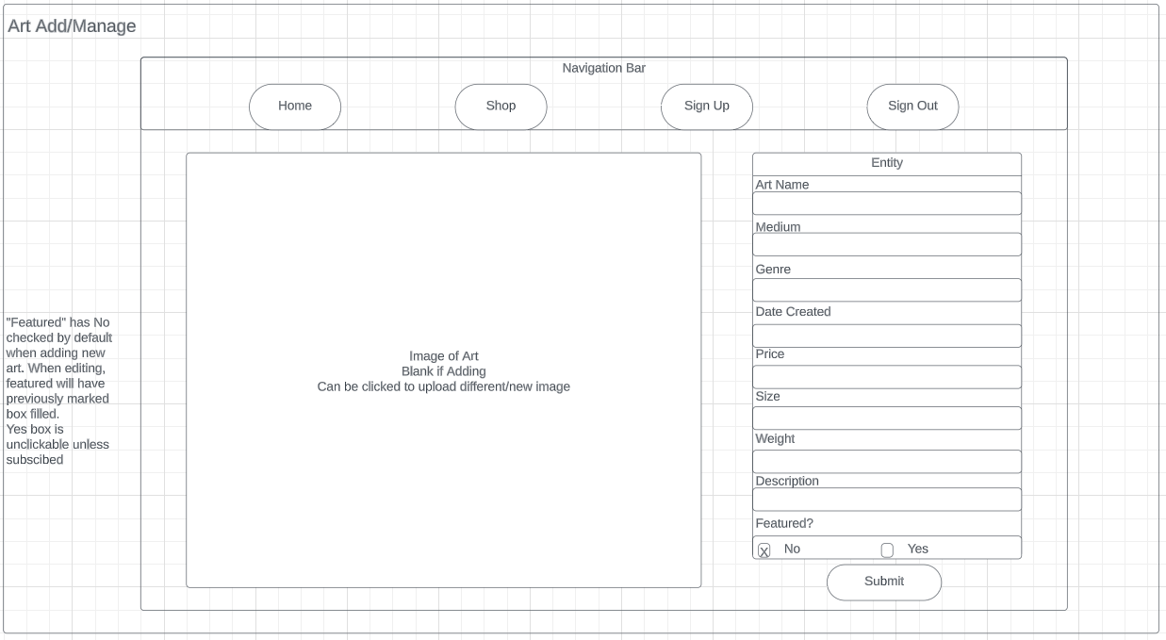

Slide 13
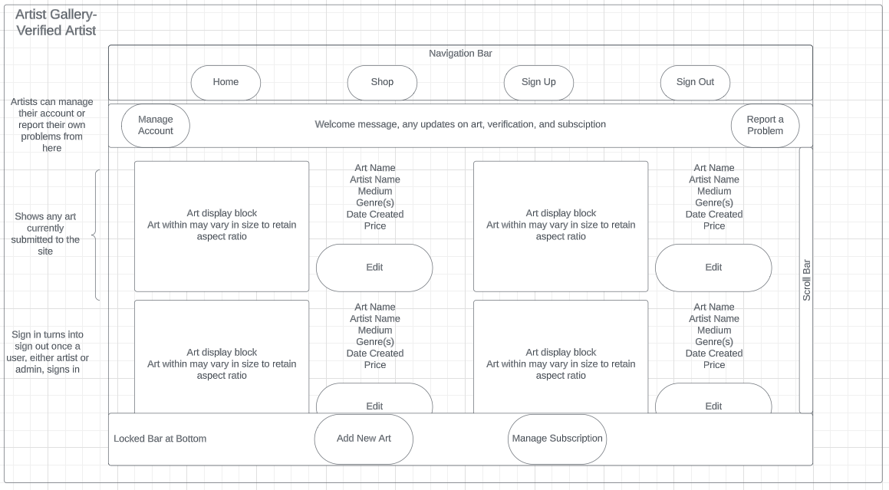

Slide 15
Admin Sign In

Slide 16
The Process
Admin signs in
Admin then is able to view the admin management page
All other pages have admin tools-Shop has remove art button, etc
After doing admin things, admin signs out, getting returned home

Slide 18
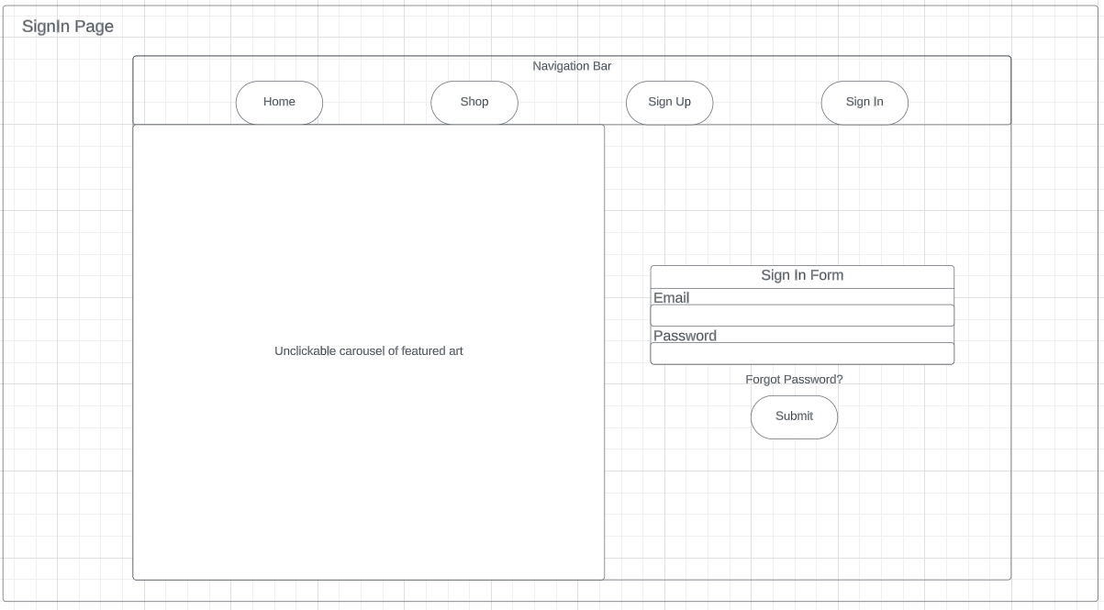

Slide 19
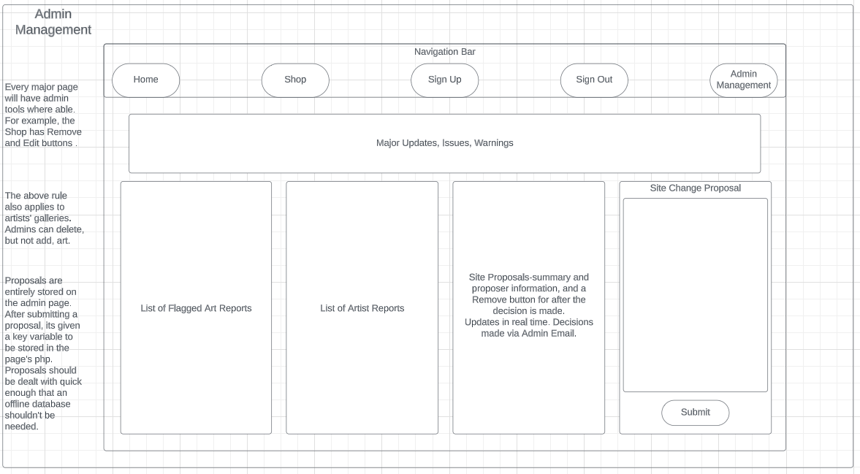

Slide 21
Forgot Password

Slide 22
The Process
User enters site
User attempts to sign in
User fails
User goes through password recovery
User uses issued password to change account

Slide 24
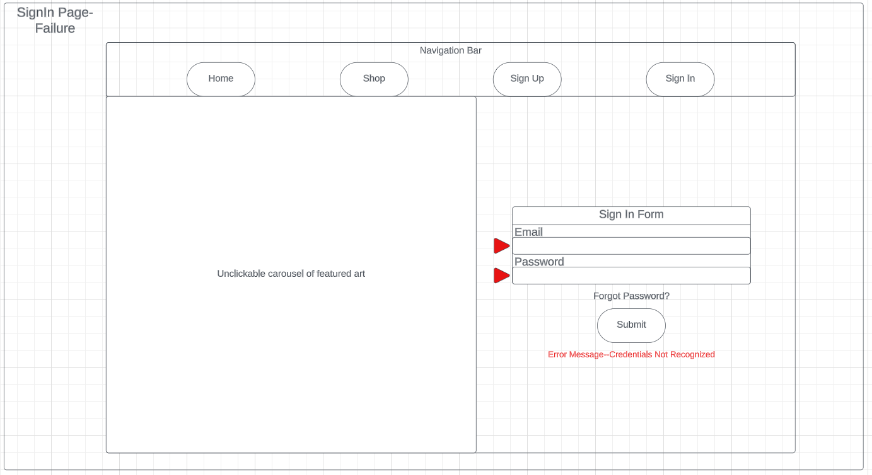

Slide 25
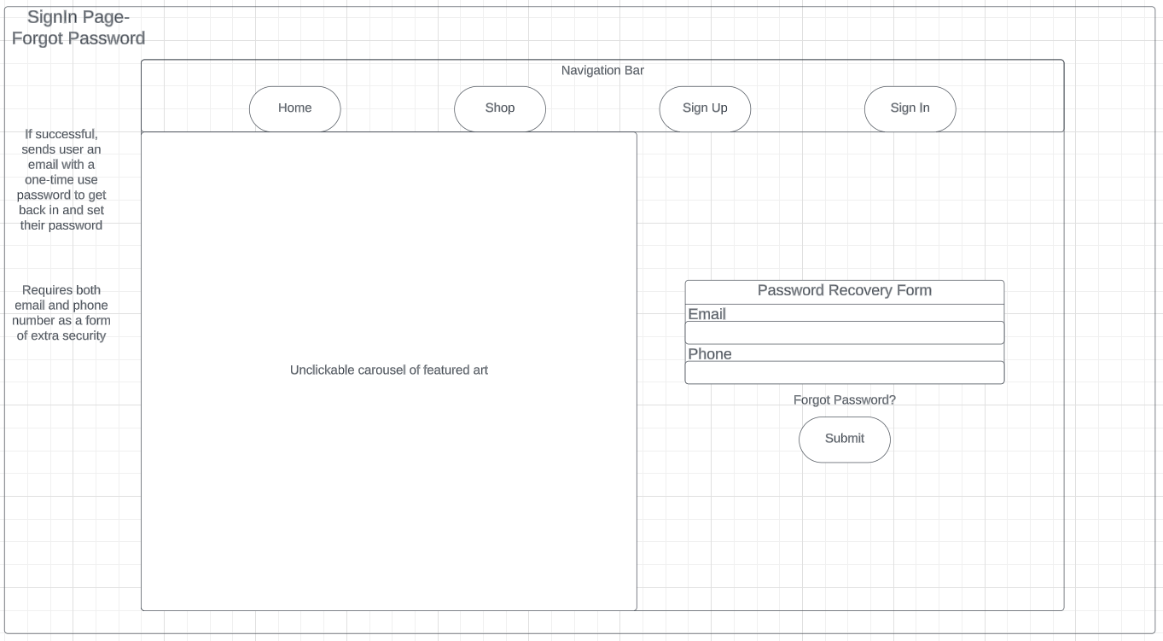

Slide 27
